Slide 1
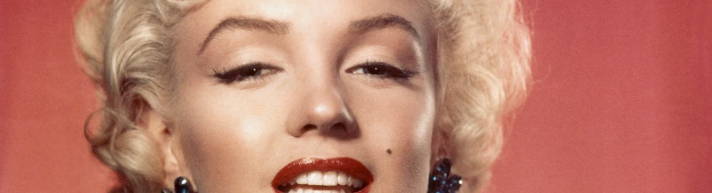
Famous Name Changers
This is Marilyn Monroe. Marilyn is not her real name. It´s Norma Jeane Mortenson

Slide 2

Do you like your name?
+Yes, i do. It is perfect. ☺
-no, i don´t. i prefer ________

Slide 3
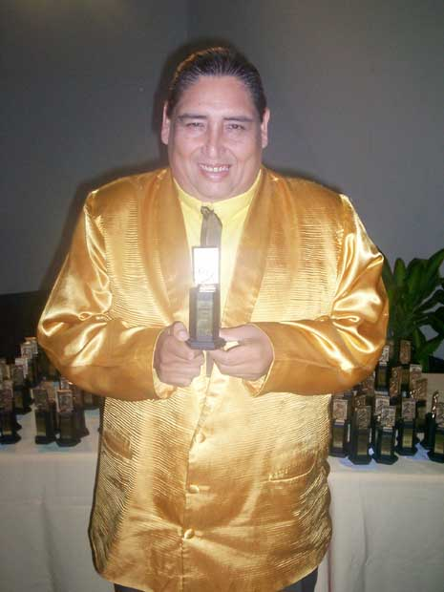
Is his real name Tongo?
No, it isn´t.
His real name is Abelardo Gutiérrez Alanya

Slide 4
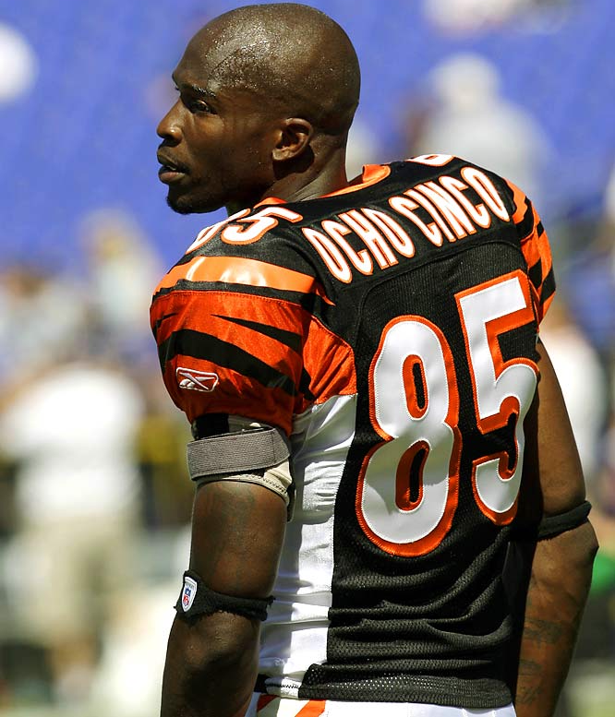
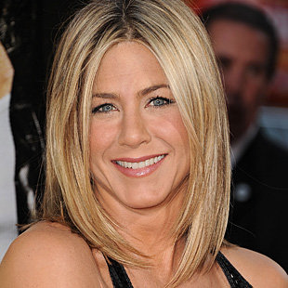
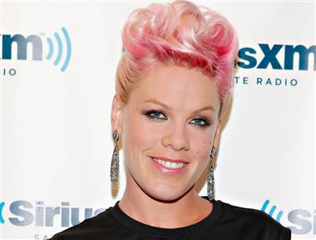
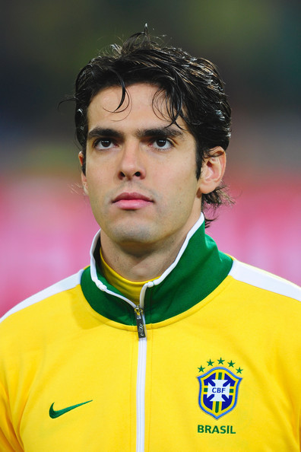
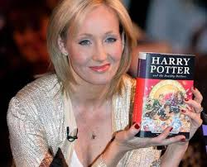
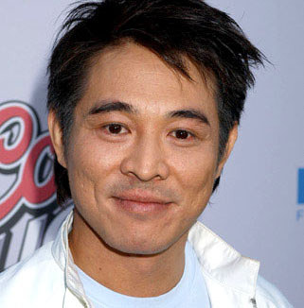
1
3
Chad Johnson
Ricardo Izecson dos Santos Leite
6
Jennifer
Anastassakis
Who is number ___?
I think number ____ is __________.
Alecia Moore
Li Lian Jie
2
Joanne Kathleen Rowling
4
5

Slide 5
1
Who is number 1 ?
Number 1 is Jennifer Aniston, but her real name is Jennifer Anastassakis.
Who is number __ ?
Number __ is ________, but her/his real name/full name is _________________.

